Slide 1
RCGP
LEARNING
EVENT
ANALYSIS
TEMPLATE GUIDANCE
Lubna Latif
CRUK Health Facilitator
Bradford and Leeds

Slide 2


Why do a learning event analysis?

Slide 3
QOF requirement Quality Improvement activity.
CPD: Describing and analysing a learning event is an important skill that will be scrutinised in your appraisal and revalidation.
Develop skills: This template gives you and your practice colleagues an opportunity to develop this.
A LEA done well is worth the effort for the benefits it can bring for you, your patients, and the practice as a whole.
Notes:
Here are some tips based on the submissions RCGP have received so far:

Slide 4
Choice
of
case
is
important

Slide 5
Choose a case that requires:
Significant reflection
Likely to generate learning and change to practice.
Good examples are a delayed diagnosis or a patient diagnosed after an emergency admission.

Slide 6
Choose a case that requires significant reflection, and is likely to generate learning and change to practice. Good examples are a delayed diagnosis or a patient diagnosed after an emergency admission.
Avoid cases that are unlikely to provoke new learning, such as a patient with a breast lump appropriately referred on first presentation.

Slide 7
Choose a case that requires significant reflection, and is likely to generate learning and change to practice. Good examples are a delayed diagnosis or a patient diagnosed after an emergency admission.
Avoid cases that are unlikely to provoke new learning, such as a patient with a breast lump appropriately referred on first presentation.
Only consider cases involving external problems (e.g. hospital delays) if the practice can demonstrate that, as a consequence of that case, it has been instrumental in attempts to remedy the external problem.

Slide 8
An effective LEA is
a practice activity

Slide 9
LEA is best done as a practice activity, perhaps in the course of a practice team meeting.
It should specify who participated and who was responsible for actioning any changes.
The LEA report should say whether all relevant individuals attended and whether the conclusions should be discussed with any other staff inside or outside the practice.

Slide 10
LEA is best done as a practice activity, perhaps in the course of a practice team meeting.
Participants: It should specify who participated and who was responsible for actioning any changes.
The LEA report should say whether all relevant individuals attended and whether the conclusions should be discussed with any other staff inside or outside the practice.

Slide 11
LEA is best done as a practice activity, perhaps in the course of a practice team meeting.
It should specify who participated and who was responsible for actioning any changes.
The LEA report should say whether all relevant individuals attended and whether the conclusions should be discussed with any other staff inside or outside the practice.

Slide 12
Action the actions

Slide 13
An effective LEA not only identifies the learning points and actions to be taken but puts those changes into effect and monitors their impact.
Specify who in the practice (staff member or groups) will be responsible for your action points and decide how their impact will be monitored.

Slide 14
An effective LEA not only identifies the learning points and actions to be taken but puts those changes into effect and monitors their impact.
Specify who in the practice (staff member or groups) will be responsible for your action points and decide how their impact will be monitored.

Slide 15
An external reviewer
can only assess
what is written

Slide 16
Try to address all the points suggested under each question, and any others you consider relevant. If you don’t write key information down, the reviewer will assume that it was not considered or done.
Provide sufficient background to enable the external reviewer to understand what happened. It is best to provide details of all potentially relevant interactions with the patient for the year prior to diagnosis.

Slide 17
Try to address all the points suggested under each question, and any others you consider relevant. If you don’t write key information down, the reviewer will assume that it was not considered or done.
Provide sufficient background to enable the external reviewer to understand what happened. It is best to provide details of all potentially relevant interactions with the patient for the year prior to diagnosis.

Slide 18

The Template and What to Expect

Slide 19
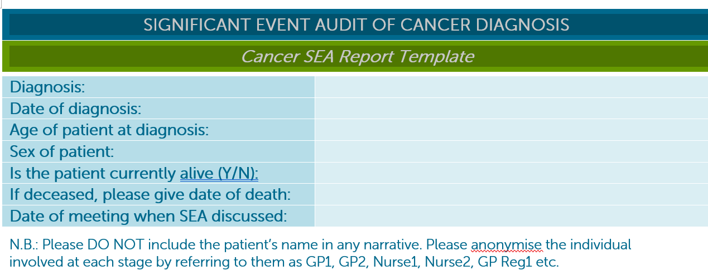

Slide 20
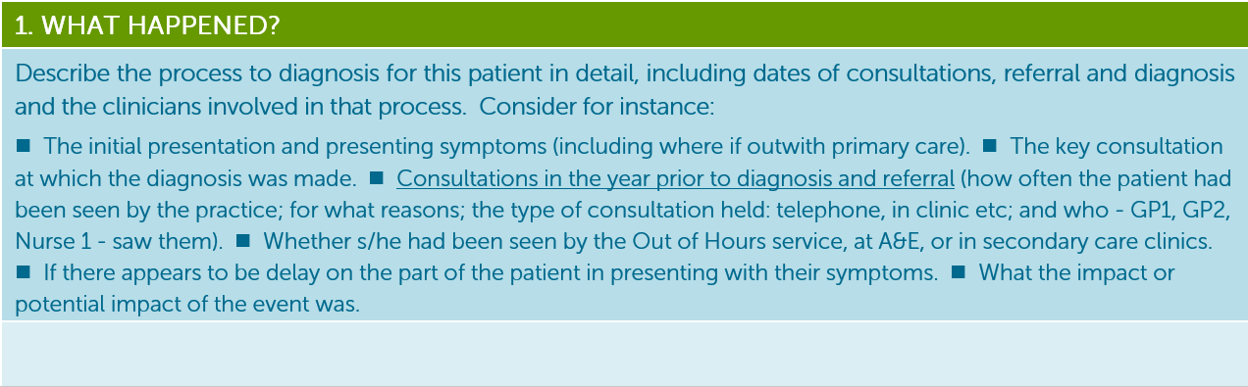

Slide 21
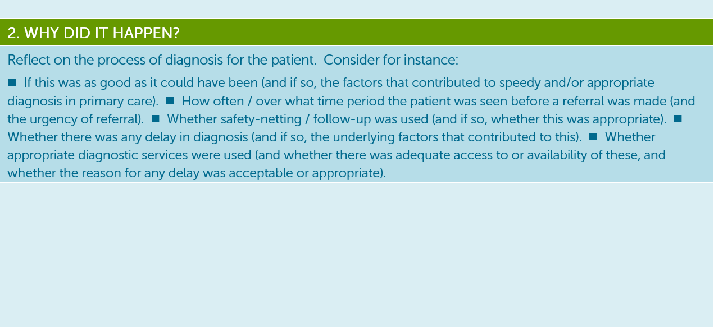

Slide 22
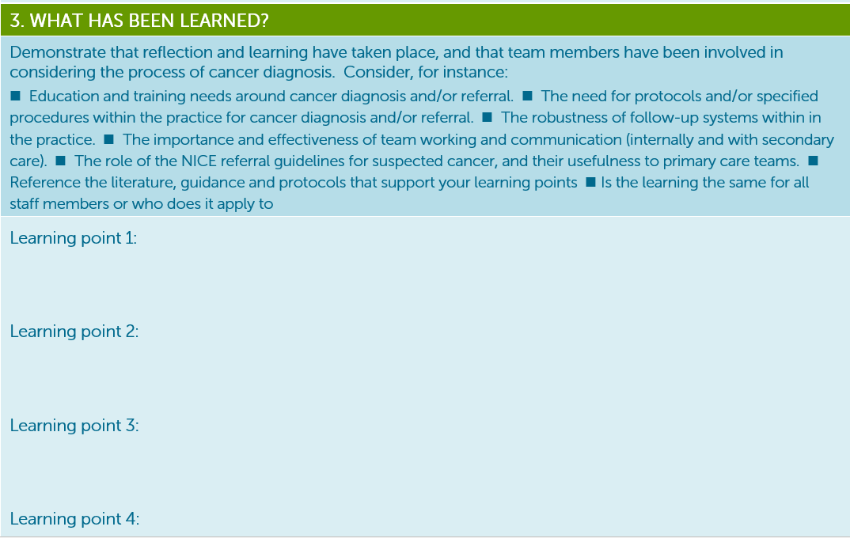

Slide 23
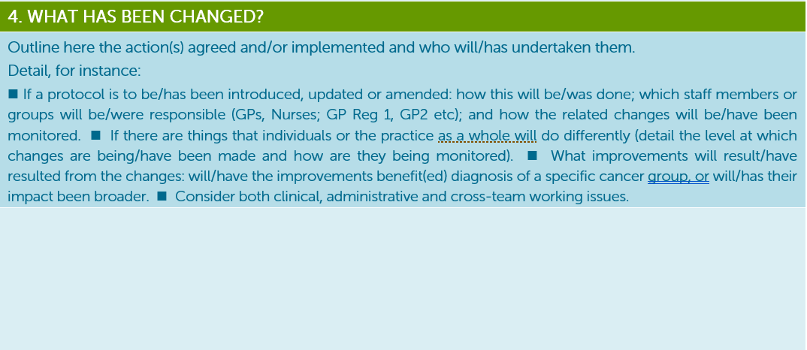

Slide 24
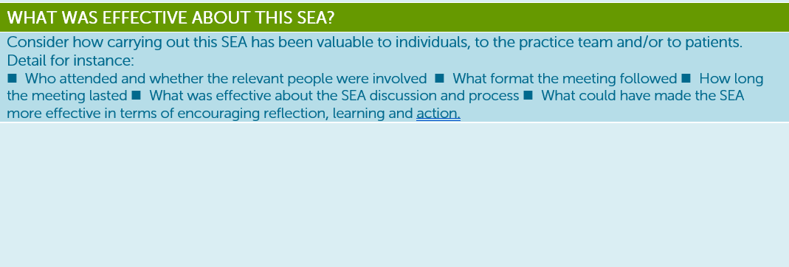

Slide 25
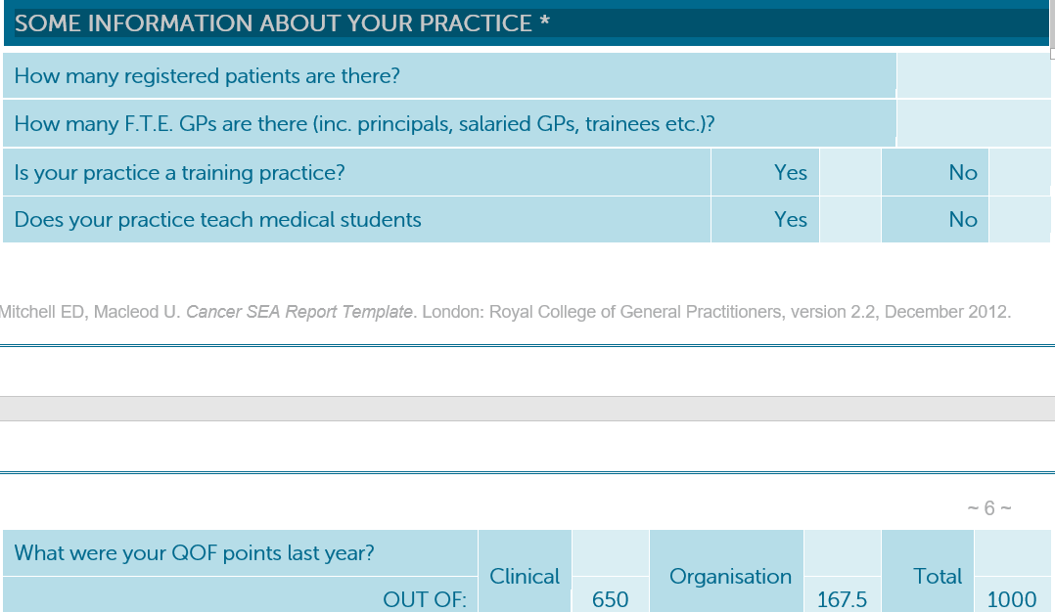

Slide 26
Points to consider
Who in your practice will take responsibility for pulling together cases to be reviewed?
What cases will be discussed, late diagnosis, emergency diagnoses?
Where will the cases be reviewed? PCN learning sessions monthly
When will your PCN review cases, eg, monthly, quarterly etc.
Who will follow up on actions, learnings etc.

Slide 27

Lubna Latif
Cancer Research UK Facilitator
Lubna.Latif@cancer.org.uk
07827 986437
Notes:
There is an expression of interest sheet that is making it’s way round. Please do fill it in and we can discuss your needs and how we can work together to help support you in achieving the spec.
Or you can take a photo of my contact details to email or call me to organise for me to come to your PCN to discuss your needs and how we can work together to help support you in achieving the spec.
Thank you.

